Slide 1
Applied Data Science Capstone
IBM Data Science
Ameya Koranne
04/10/2023

Slide 2


Ameya Koranne
04/10/2023

Slide 3

Outline
Executive Summary
Introduction
Methodology
Results
Conclusion
Appendix

Slide 4
Executive Summary
Summary of methodologies:
Data Collection API
Data Collection with Web Scraping
Data Wrangling
Exploratory Data Analysis (EDA) Using SQL
EDA with Data Visualisation
Interactive Visual Analytics with Folium
Interactive Dashboard with Plotly Dash
Machine Learning Predictive Analysis (Classification Method)
Summary of all results:
Exploratory Data Analysis Results
Interactive Analytics and Dashboard (Screenshots)
Predictive Analysis Results

Slide 5
Introduction
Project background and context:
SpaceX advertises Falcon 9 rocket launches on its website with a cost of $62-Million unlike other providers which cost upwards of $165-Million each. Much of the savings is because SpaceX can reuse the first stage. Therefore, if we can determine if the first stage will land, we can determine the cost of a launch by gathering information about SpaceX and creating dashboards for the team. We will also determine if SpaceX will reuse the first stage. We will train a machine learning model and use public information to predict if SpaceX will reuse the first stage.
We can then help SpaceY to compete with SpaceX with our insights.
Problems you want to find answers:
How to improve the chances of first stage successful landings?
What factors affect the first stage successful landings?
What is the probability of using first stage again after successful landing?

Slide 6

Section 1

Slide 7
Methodology
Executive Summary
Data collection methodology:
Collected using SpaceX Rest API
Collected by Web Scraping from Wikipedia
Performed data wrangling:
Data filtering
Replacing null values with mean values where applicable
One Hot Encoding to turn categorical values into numerical values
Performed Exploratory Data Analysis (EDA) using visualisation and SQL
Performed interactive visual analytics using Folium and Plotly Dash
Performed predictive analysis using classification models:
Logistic Regression, Support Vector Machine, K-Nearest Neighbours, Decision Tree were built, tuned and evaluated to determine best result.

Slide 8
Data Collection
Data columns collected using Spacex Rest API include:
FlightNumber, Date, BoosterVersion, PayloadMass, Orbit, Launchsite, Outcome, Flights, GridFins, Reused, Legs, LandingPad, Block, ReusedCount, Serial, Longitude, Latitude
However, we need more information such as FlightNo., Time, etc which we collected from Wikipedia using web scraping. The following columns were collected:
Flight No., Date and time, Launch site, Payload, Payload mass, Orbit, Customer, Launch outcome
The collected data was stored in a Pandas DataFrame, processed and exported to a .csv file

Slide 9
Data Collection – SpaceX API
Request and parse the SpaceX launch data using the GET request
Decode the response content using .json() and turn it into a Pandas dataframe using .json_normalize()
Use columns - rocket, payloads, launchpad, cores - to gain more information
Look for nulls and replace them with mean values. Later, export data to flat file (.csv)
Combine the columns into a dictionary. Filter to include only Falcon 9 launches
[Click Here for my Github link] to my Data Collection using API notebook

Slide 10
Data Collection - Scraping
Request the Falcon9 Launch HTML page, as an HTTP response
Create a BeautifulSoup object from the HTML response
Collect all relevant columns from the HTML table headers using .find_all()
Create a Pandas DataFrame and export as a .csv file
Parse the launch HTML tables. Create an empty dictionary and fill it with data
[Click Here for Github Link] to my Data Collection with Web Scraping Notebook

Slide 11
Data Wrangling
We will start with converting outcomes with labels - True Ocean, True RLTS, True ASDS - into Training Labels with “1” meaning the booster successfully landed
And outcomes with labels - False Ocean, False RLTS, False ASDS - to “0” meaning it was unsuccessful
Perform calculations to learn:
Number of launches on each site
Occurences of each orbit
Number of landing outcomes
Export to .csv file
[Click Here for Github Link] to my Data Wrangling Notebook

Slide 12
EDA with Data Visualization
Scatter Plots help us understand the relationship between two continuous variables. They are great with complex data. So we used scatter plots to chart variables to learn the relationship between them:
FlightNumber vs. PayloadMass
FlightNumber vs. LaunchSite
PayloadMass vs. LaunchSite
FlightNumber vs. Orbit
PayloadMass vs. Orbit
In addition to scatter plots we used a bar chart to compare success rate for each orbit and a line chart to view the timeline of average success rate.
[Click here for Github Link] to my EDA with Data Visualisation Notebook

Slide 13
EDA with SQL
Summary of SQL queries we performed:
Display the names of the unique launch sites in the space mission
Display 5 records where launch sites begin with the string 'CCA'
Display the total payload mass carried by boosters launched by NASA (CRS)
Display average payload mass carried by booster version F9 v1.1
List the date when the first successful landing outcome in ground pad was achieved
List the names of the boosters which have success in drone ship and have payload mass greater than 4000 but less than 6000
List the total number of successful and failure mission outcomes
List the names of the booster_versions which have carried the maximum payload mass (Used a subquery)
List the failed landing_outcomes in drone ship, their booster versions, and launch site names for in year 2015
Rank the count of landing outcomes (such as Failure (drone ship) or Success (ground pad)) between the date 2010-06-04 and 2017-03-20, in descending order
[Click Here for Github Link] to my EDA with SQL Notebook

Slide 14
Build an Interactive Map with Folium
We added markers with circle, pop-up label, and text label of all Launch Sites using their coordinates (latitude and longitude) to show the respective geographical locations on the interactive map we built with Folium
We added coloured markers (green for successful launches, red for failed launches) for each launch site on the map using Marker Cluster object to easily identify which launch sites have relatively high success rates
We added a line marker to calculate the distance from closest highway, railway, coastline, and city from a launch site.
[Click Here for Github Link] to my Interactive Map with Folium Notebook

Slide 15
Build a Dashboard with Plotly Dash
We added a dropdown list for all Launch Sites (to select either a specific launch site or to select combined launch sites)
Selecting a specific launch site or all launch sites option, we can view the pie chart which shows the success rate vs. failure rate
We added a Range Slider to Payload Mass variable with selectable points at 0, 2500, 5000, 7500, 10000
Added a scatter plot which operates on above range slider for payload mass and launch success.
[Click Here for Github Link] to my Dashboard with Plotly Dash file

Slide 16
Predictive Analysis (Classification)
We created a NumPy array based on column ‘Class’ in data
We standardised the data using StandardScaler() and then transformed the data. We also split our data using train_test_split()
We created GridSearchCV object to find the best parameters and calculate the accuracy of test data by using method ‘score’
We used Logistic Regression, Support Vector Machine, K-Nearest Neighbour, and Decision Tree
We found which method performs best
[Click Here for Github Link] to my Predictive Analysis Notebook

Slide 17
Results
Exploratory data analysis results
Interactive analytics demo in screenshots
Predictive analysis results

Slide 18

Section 2

Slide 19
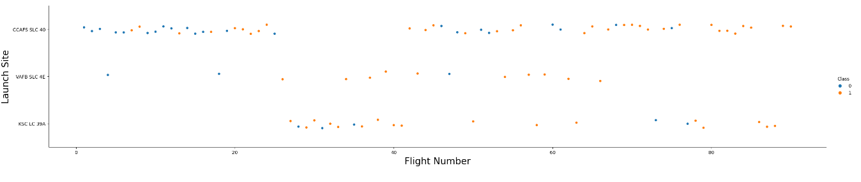
Flight Number vs. Launch Site
Observations:
Launch Site CCAFS SLC 40 has highest number of launches
VAFB SLC 4E and KSC LC 39A have lesser number of launches but their success rates are higher
Success Rate is improving for all sites as the number of launches grow

Slide 20
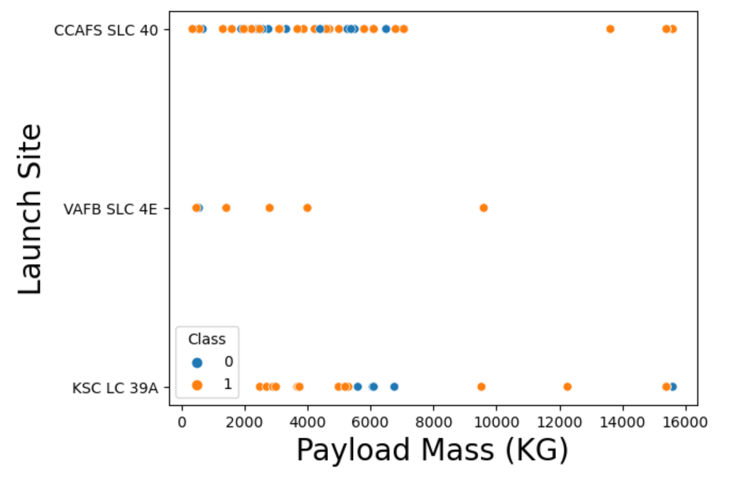
Payload vs. Launch Site
For VAFB SLC 4E launch site, there are no rockets launched for heavy payload mass(greater than 10000 Kgs)
CCAFS SLC 40 excels in heavy payload mass rocket launches with no failure so far
KSC LC 39A has one failed launch at payload mass of almost 16000 Kgs

Slide 21
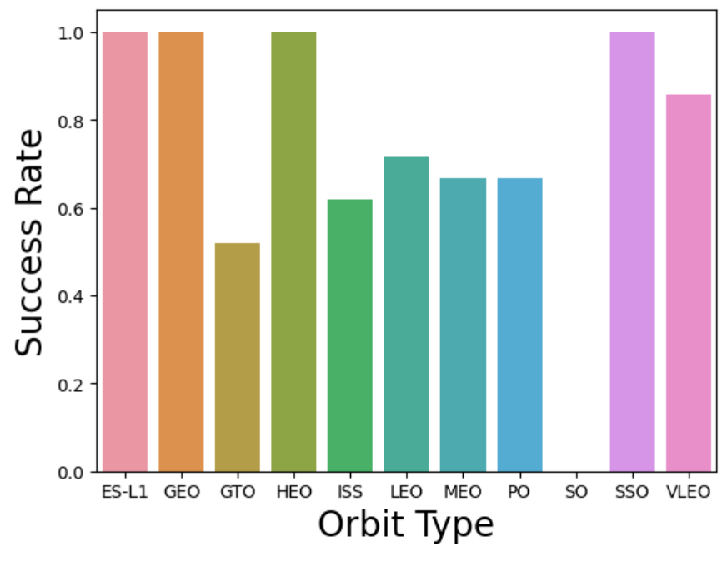
Success Rate vs. Orbit Type
Orbits ES-L1, GEO, HEO, and SSO have a perfect status, they have not failed.
Orbit ‘SO’ has a success rate of 0%
Rest of the orbits have success rate between 50% and 85%

Slide 22
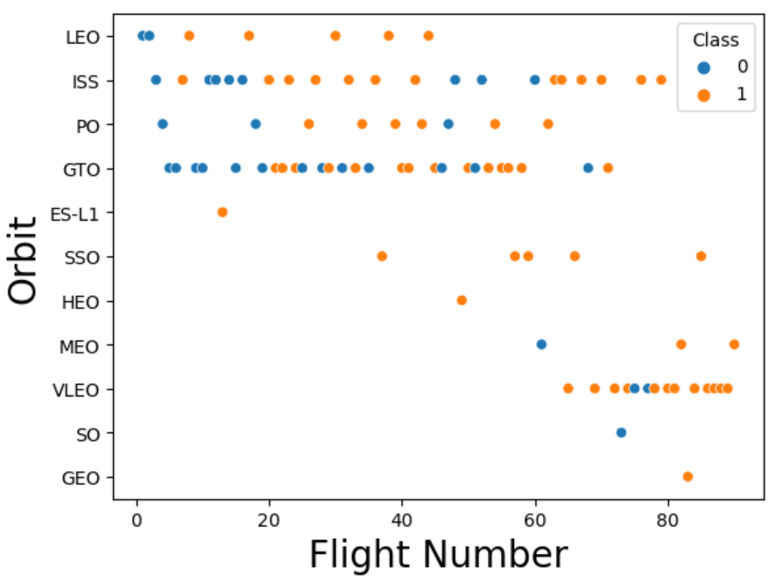
Flight Number vs. Orbit Type
In VLEO orbit the success appears related to the number of flights
ES-L1, SO, and GEO are the least preferred orbit type
There seems to be no relationship between flight number when in GTO orbit

Slide 23
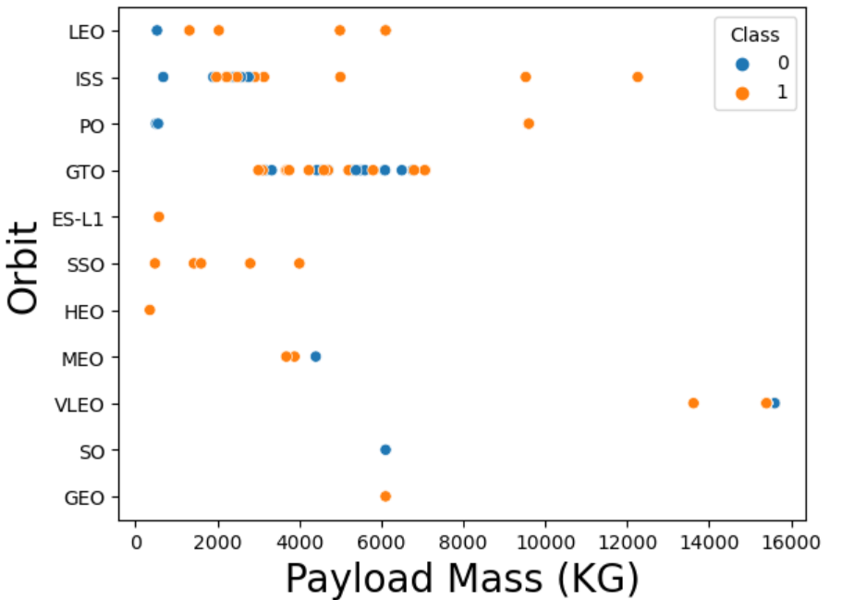
Payload vs. Orbit Type
With heavy payloads the successful landing rates are more for PO, LEO and ISS
However for GTO we cannot distinguish this as both positive and unsuccessful landings are both present

Slide 24
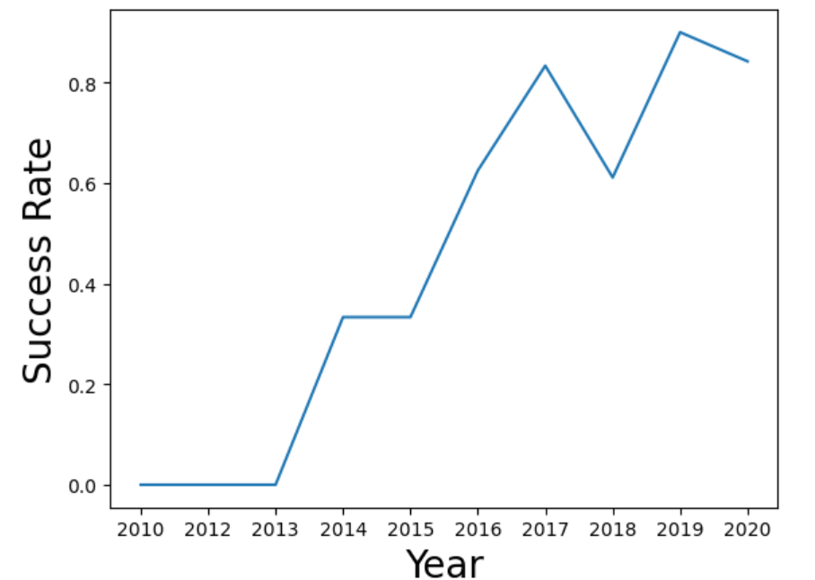
Launch Success Yearly Trend
We can observe that the success rate from 2013 kept increasing till 2020

Slide 25
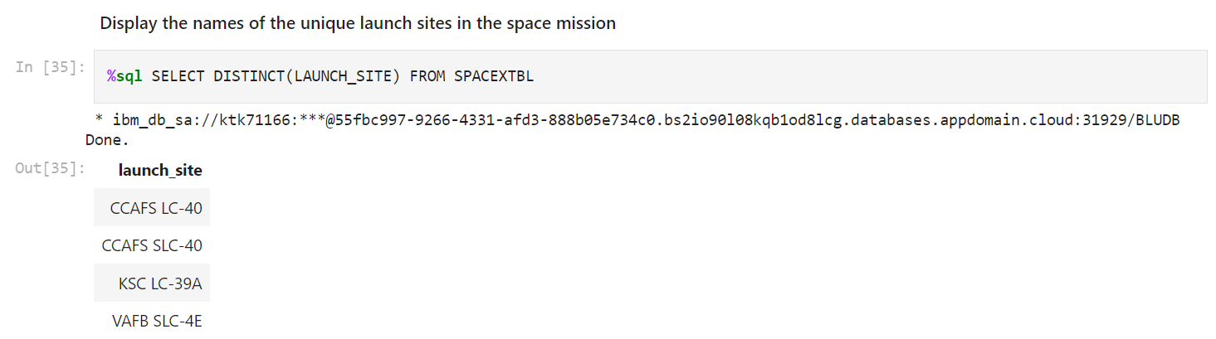
All Launch Site Names
Find the names of the unique launch sites

Slide 26
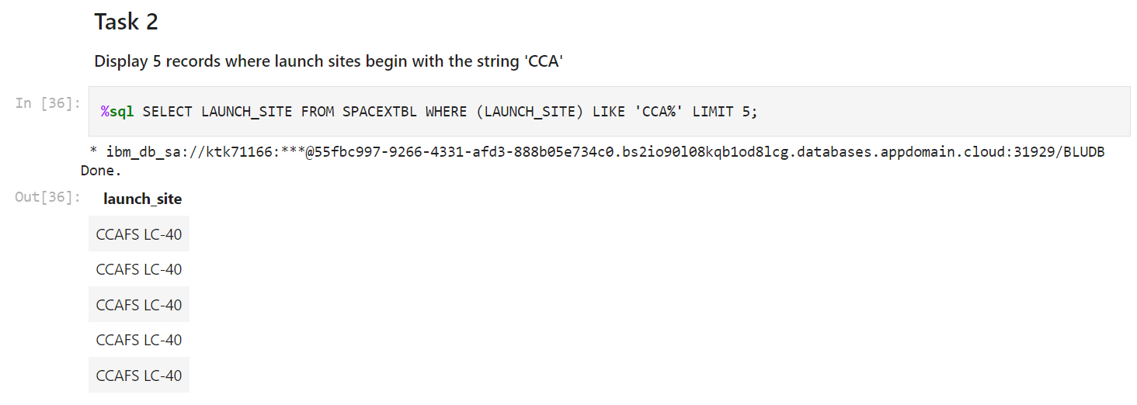
Launch Site Names Begin with 'CCA'
Find 5 records where launch sites begin with `CCA`

Slide 27
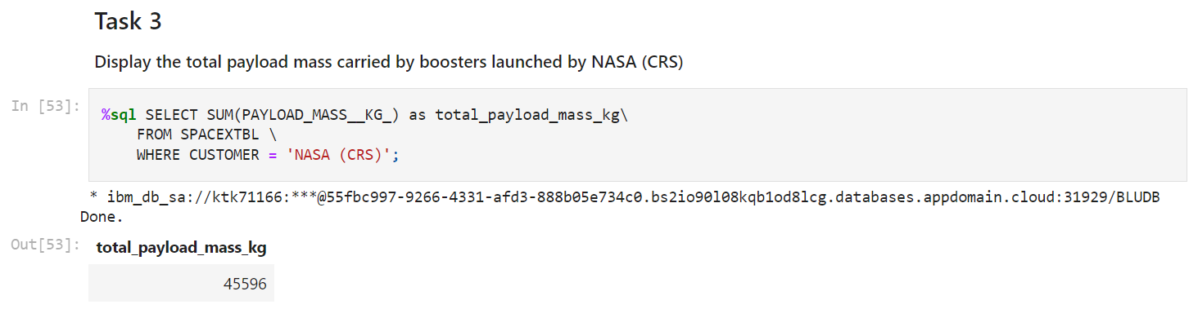
Total Payload Mass
Calculate the total payload carried by boosters from NASA(CRS)

Slide 28
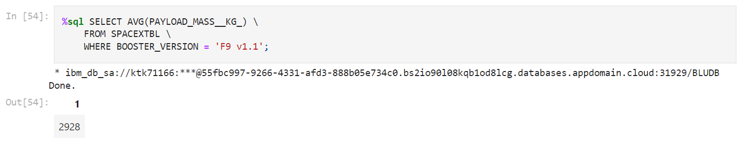
Average Payload Mass by F9 v1.1
Calculate the average payload mass carried by booster version F9 v1.1

Slide 29
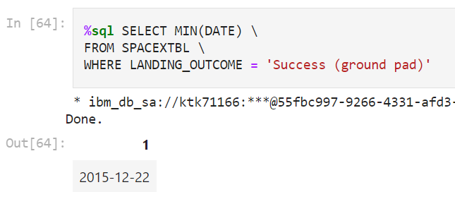
First Successful Ground Landing Date
Find the dates of the first successful landing outcome on ground pad

Slide 30
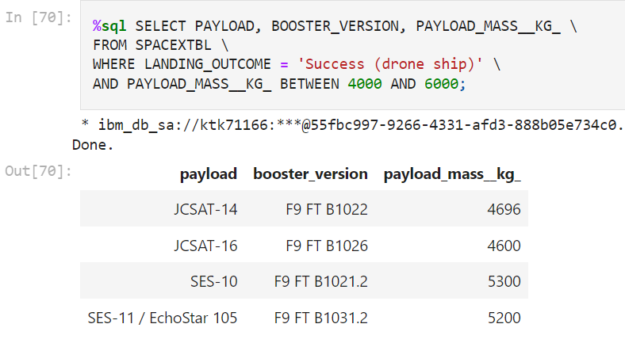
Successful Drone Ship Landing with Payload between 4000 and 6000
List the names of boosters which have successfully landed on drone ship and had payload mass greater than 4000 but less than 6000

Slide 31
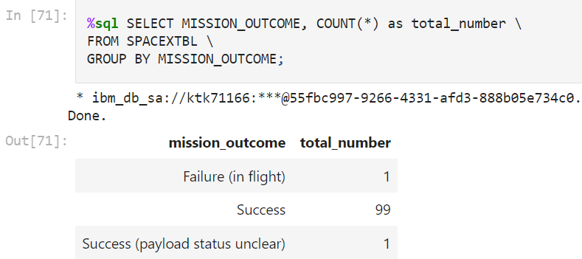
Total Number of Successful and Failure Mission Outcomes
Calculate the total number of successful and failure mission outcomes

Slide 32
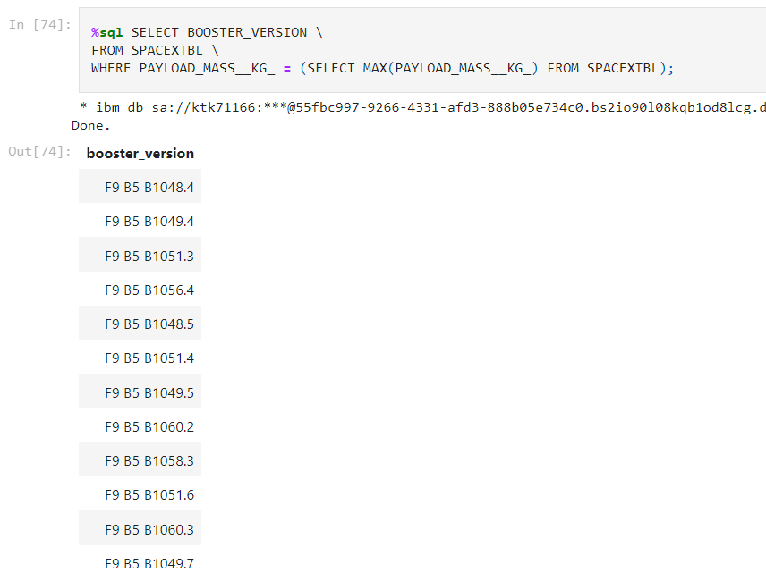
Boosters Carried Maximum Payload
List the names of the booster which have carried the maximum payload mass
(Used a subquery)

Slide 33
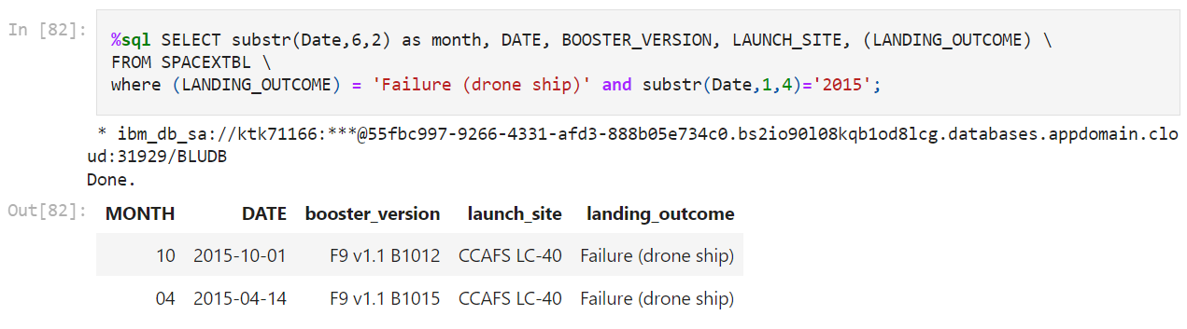
2015 Launch Records
List the failed landing_outcomes in drone ship, their booster versions, and launch site names for in year 2015

Slide 34
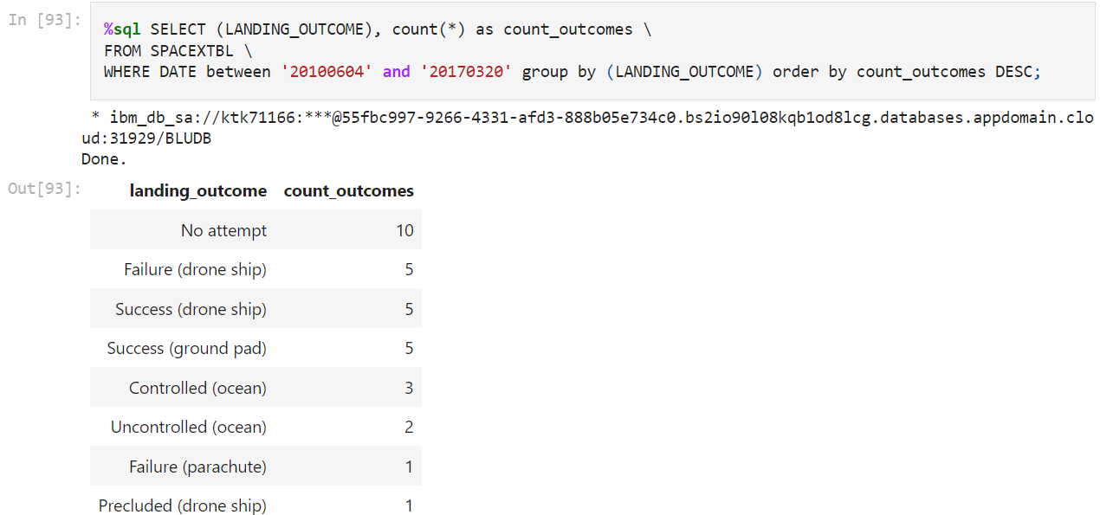
Rank Landing Outcomes Between 2010-06-04 and 2017-03-20
Rank the count of landing outcomes (such as Failure (drone ship) or Success (ground pad)) between the date 2010-06-04 and 2017-03-20, in descending order

Slide 35

Section 3

Slide 36
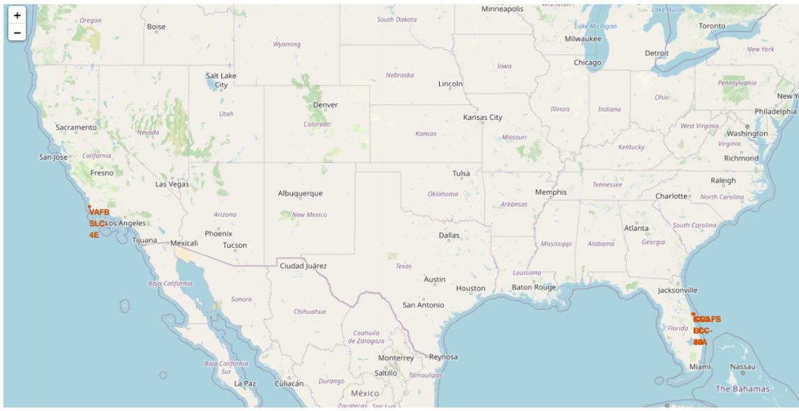
All Launch Sites’ Location on a Global Map
All launch sites are in close proximity to the equator line
All launch sites are in very close proximity to the coast
All launch sites are away from cities or populated areas

Slide 37
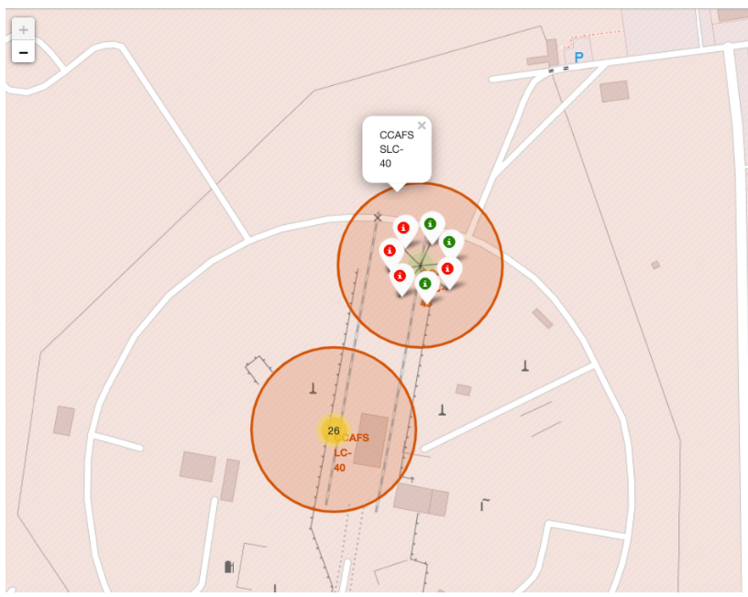
Colour-Labelled Markers On Launch Sites
Colour-labelled markers allow us to easily identify which launch sites have relatively high success rates
Green Markers are for successful launches while Red ones are for failed launches
The screenshot is an example of only one launch site

Slide 38
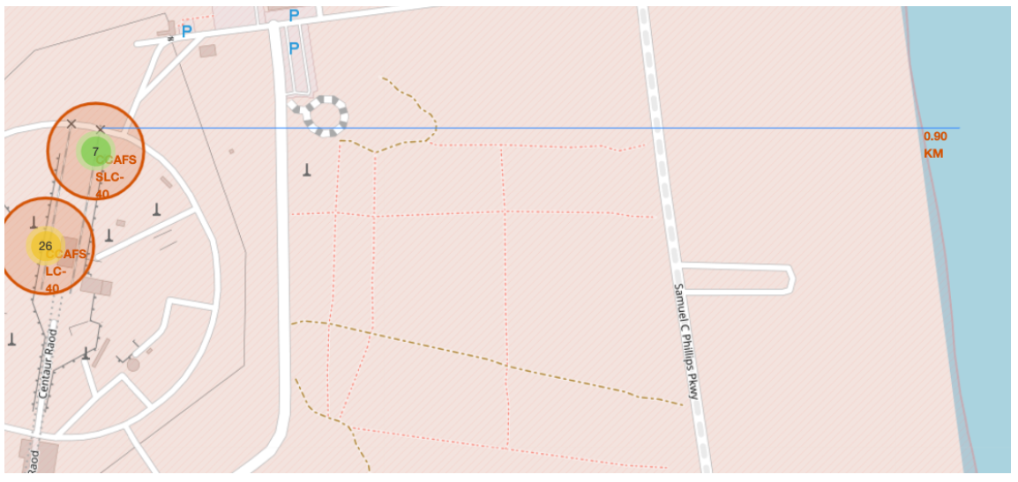
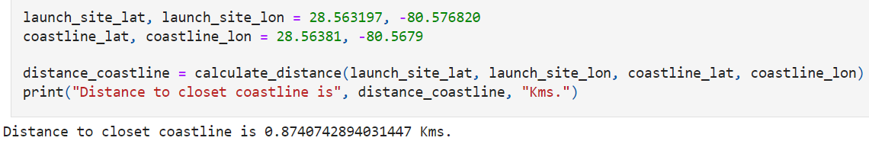
Distance to Closest Coastline from Launch Site
We have used a line marker to show the distance from the launch site to the closest coastline
It is very near to the coastline (0.9 kms)
This example is only for coast line. Please refer to appendix for more

Slide 39

Section 4

Slide 40
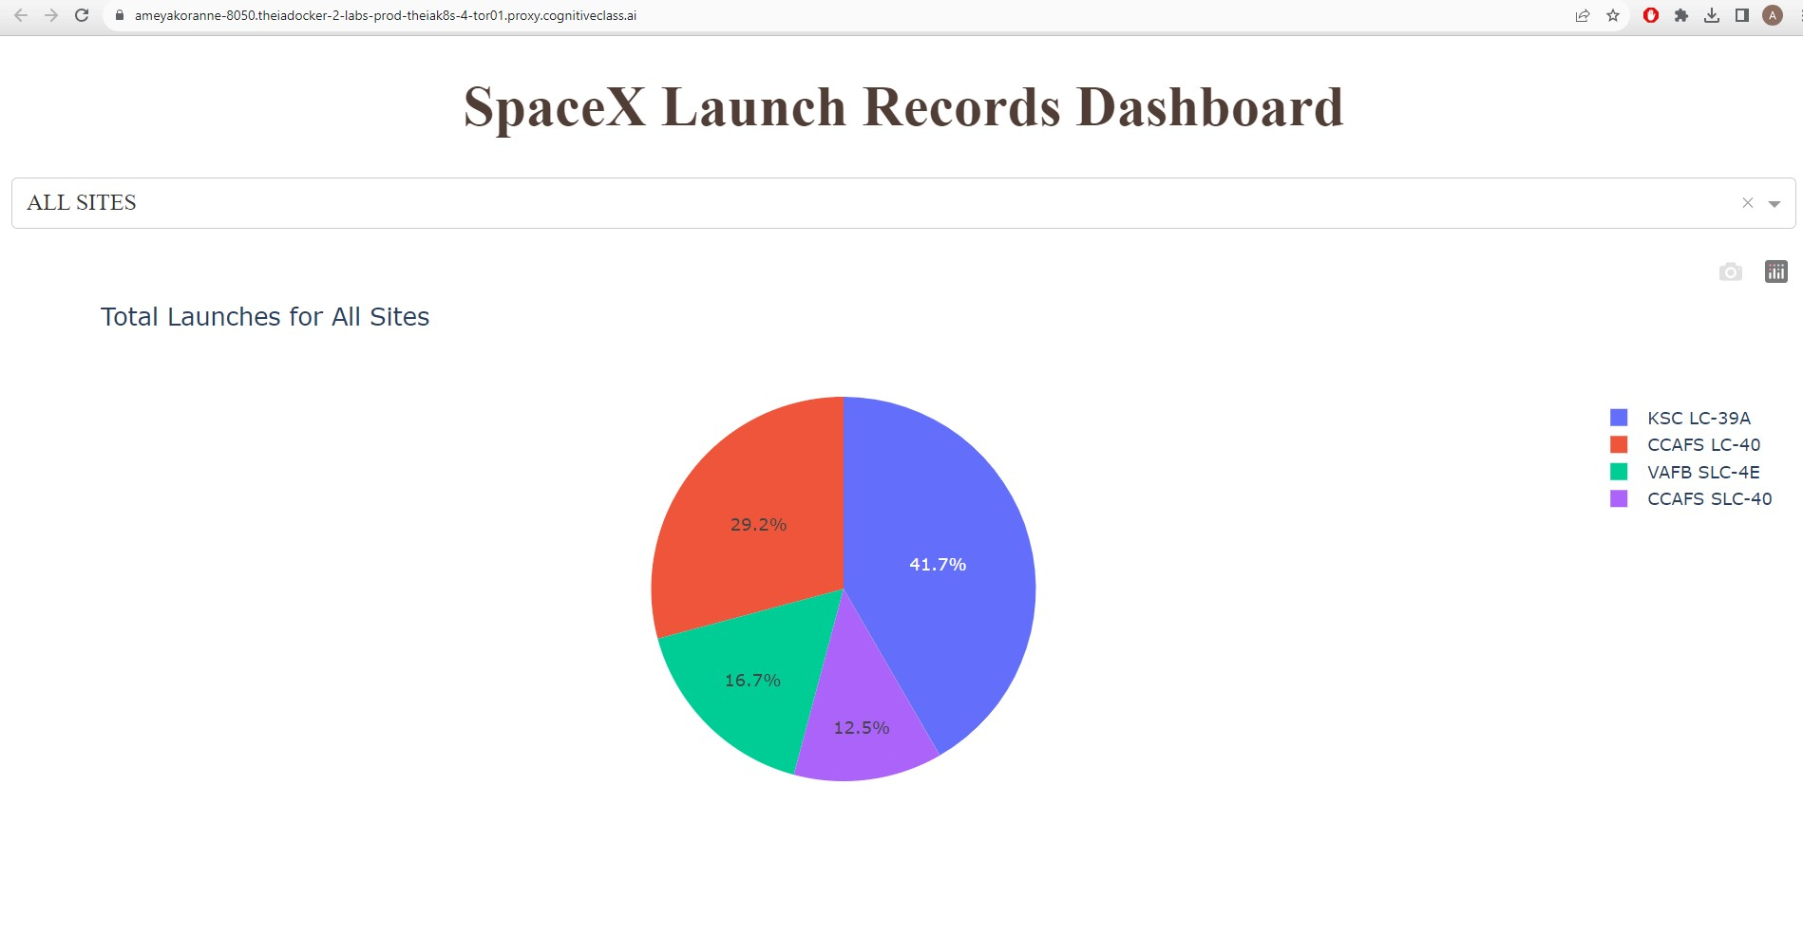
Total Successful Launch Counts for All sites
Pie Chart showing the launch successful counts for all sites
We can clearly see KSC LC-39A has the most successful launches

Slide 41
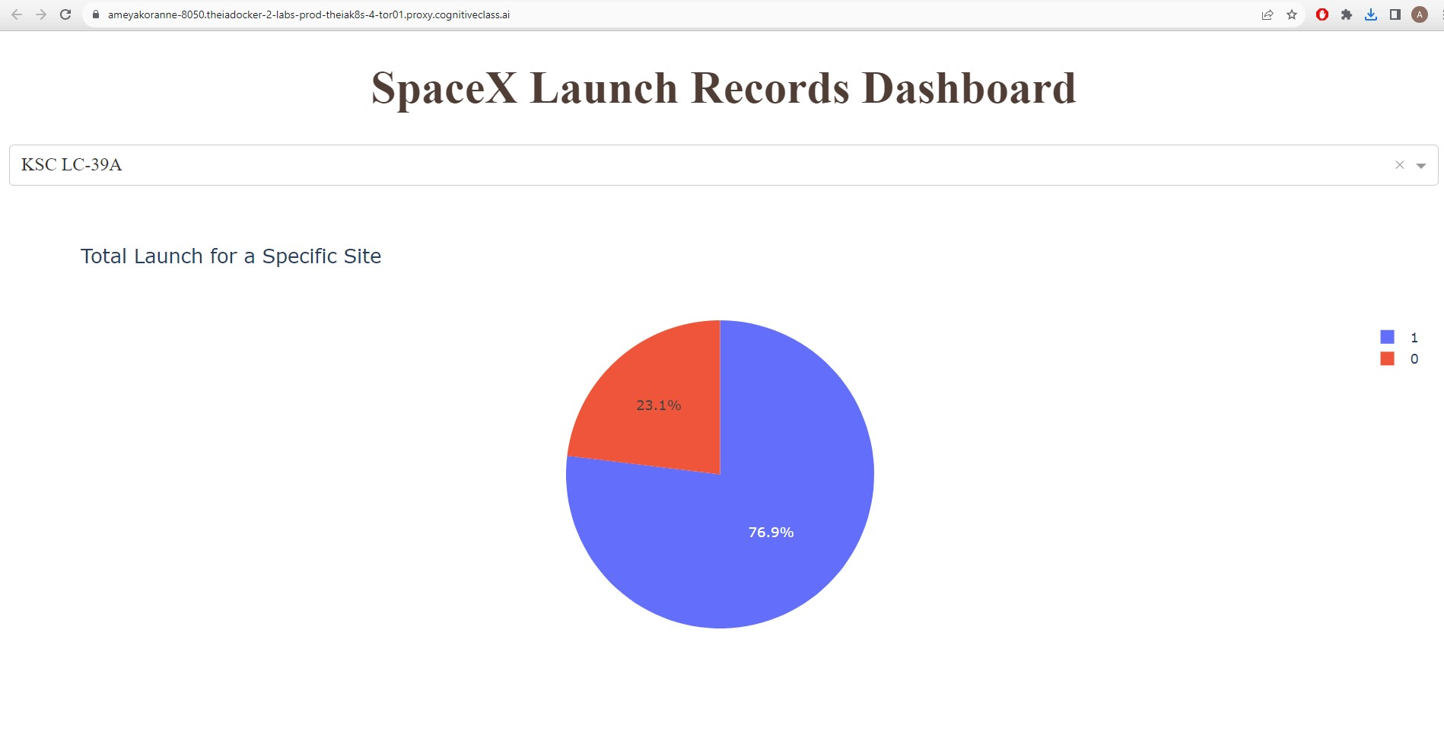
Launch Site with Highest Launch Success Ratio
Screenshot showing the piechart for the launch site with highest launch success ratio
KSC LC-39A has a 76.9% success ratio, highest amongst all launch sites

Slide 42
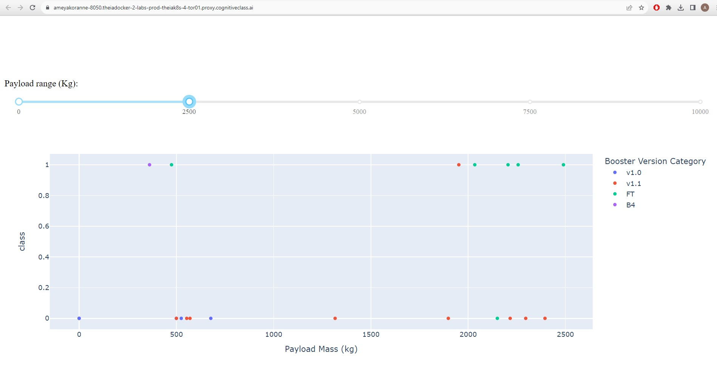
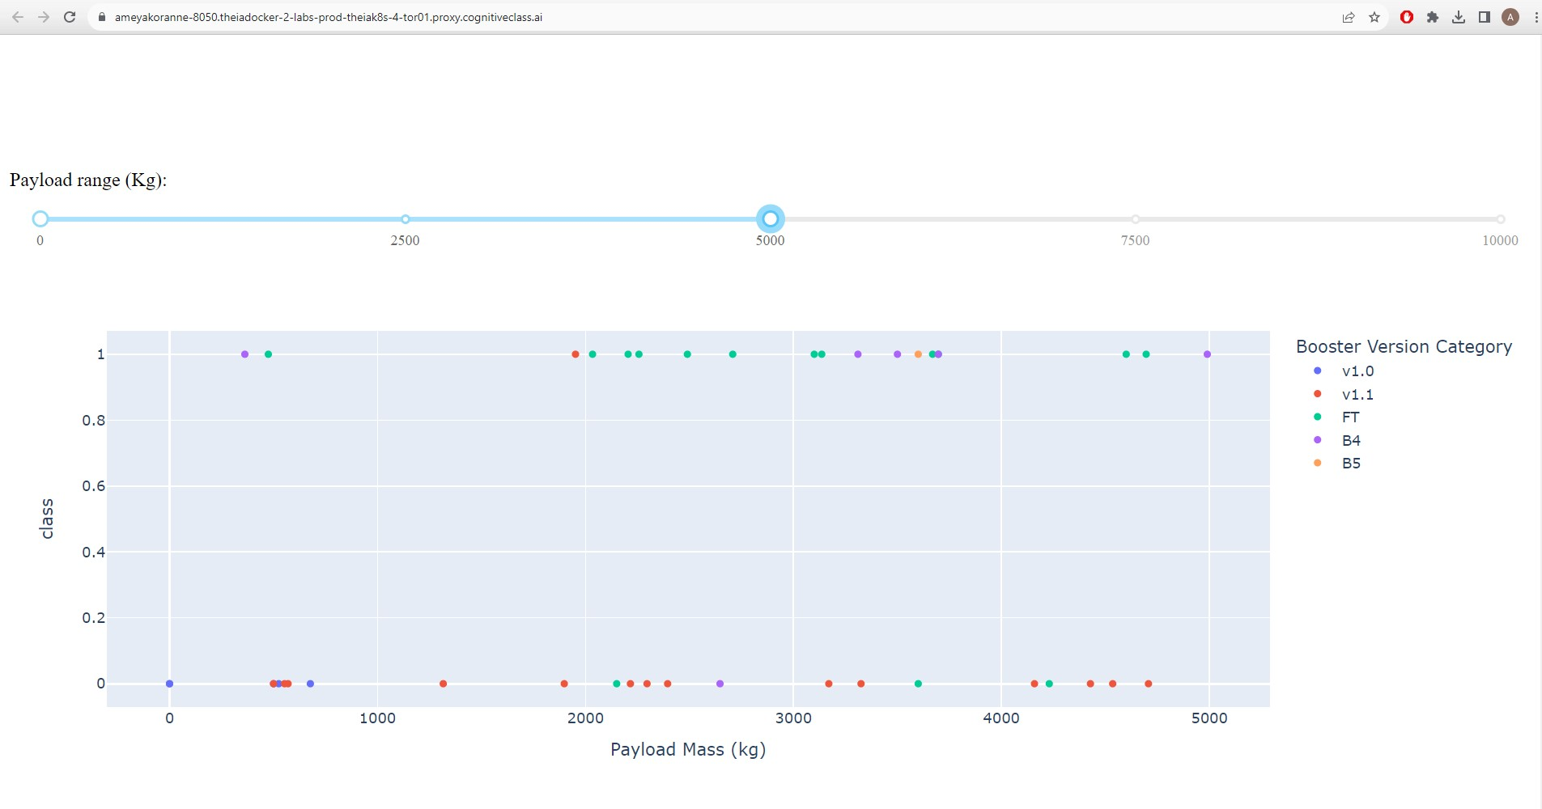
Payload vs. Launch Outcome Ranges
Showing screenshots of Payload vs. Launch Outcome scatter plot for all sites, with different payload selected in the range slider

Slide 43

Section 5

Slide 44
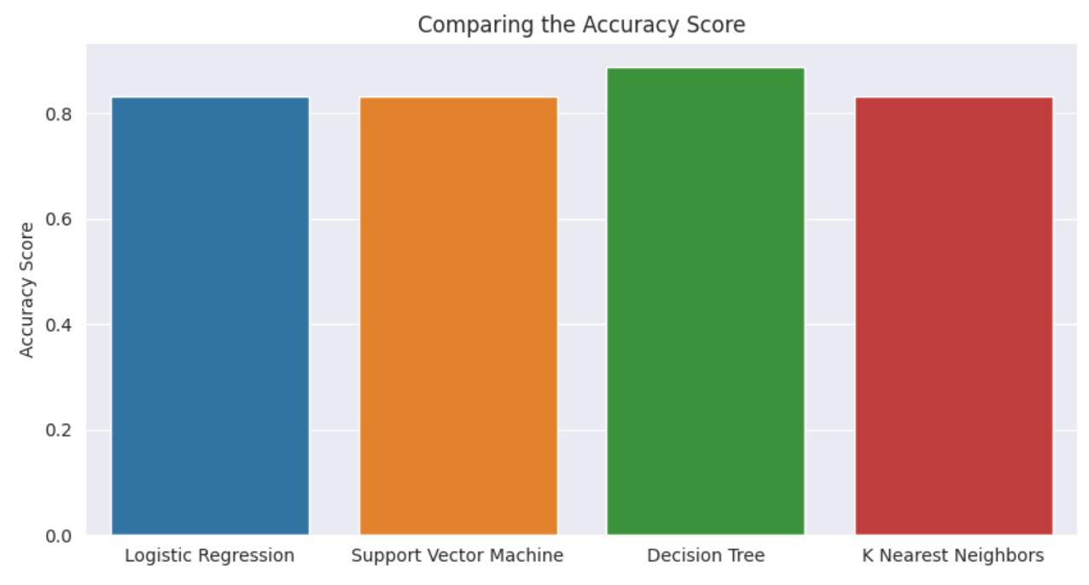
Classification Accuracy
We can easily see that Decision Tree model has the highest classification accuracy (0.88) and the rest are slightly behind at (0.83)

Slide 45
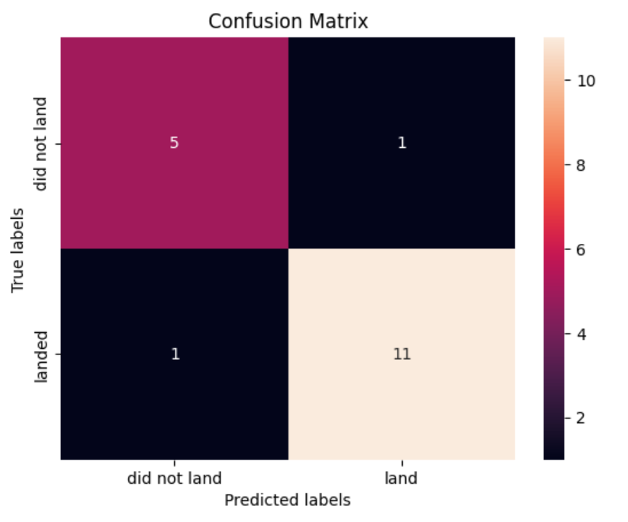
Confusion Matrix
Showing the confusion matrix of the best performing model - Decision Tree

Slide 46
Conclusions
We can conclude that first stage landings on a ‘drone ship’ and ‘ground pad’ have better success rates
Payload Mass below 6000 kgs have a higher success rate as compared with heavier payloads
Classification evaluation metric suggests that Decision Tree is the best algorithm for our dataset
Orbits ES-L1, GEO, HEO, and SSO have a 100% success rate
Launch Site KSC LC-39A has the most successful (77%) launch rate amongst all the launch sites
We can see the upward trend that success rate is growing since 2013

Slide 47
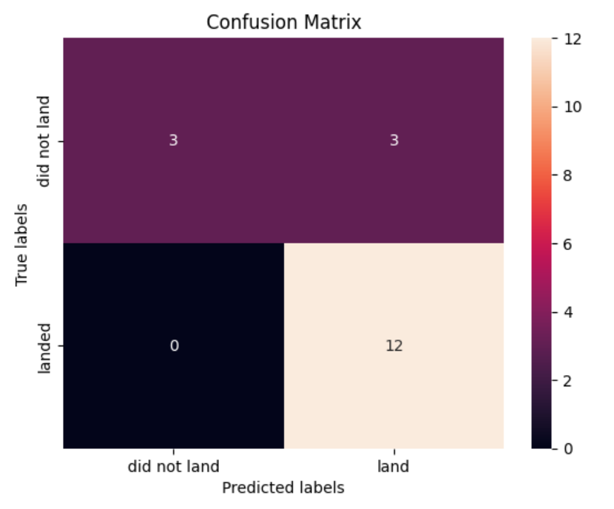
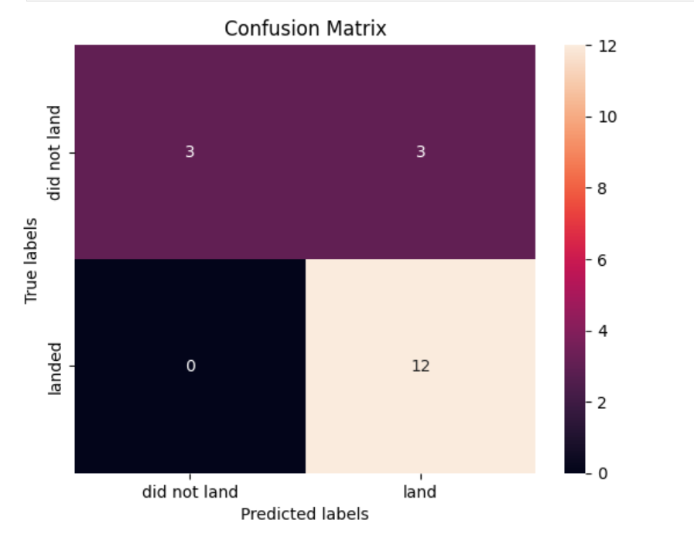
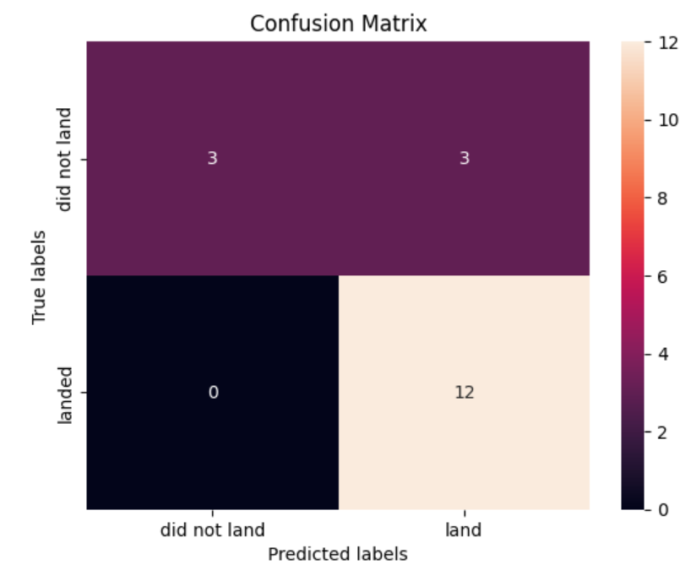
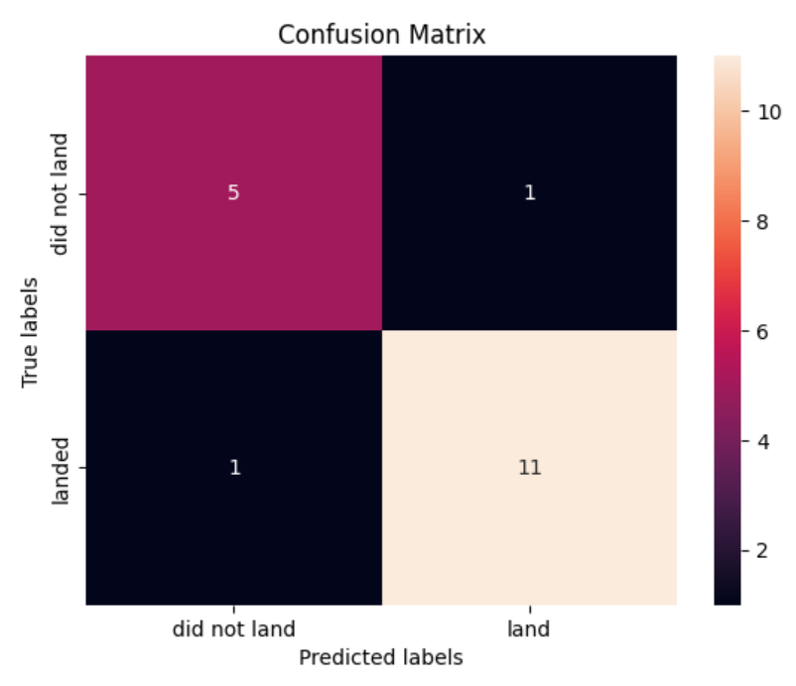
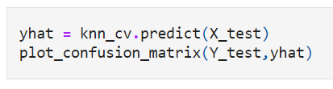
Appendix - Comparison
A quick comparison of all models - Logistic Regression, SVM, Decision Tree and KNN algorithms
Sample code to generate Confusion Matrix:

Slide 48
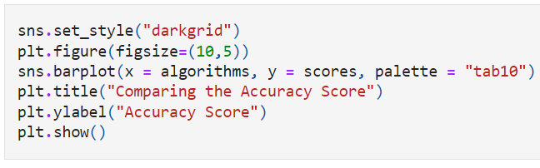
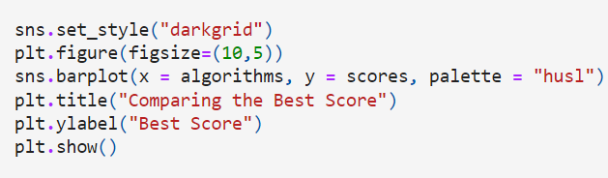
Appendix - Code to Compare Best Accuracy and Best Score (BarPlot)
Best Accuracy
Best Score

Slide 49
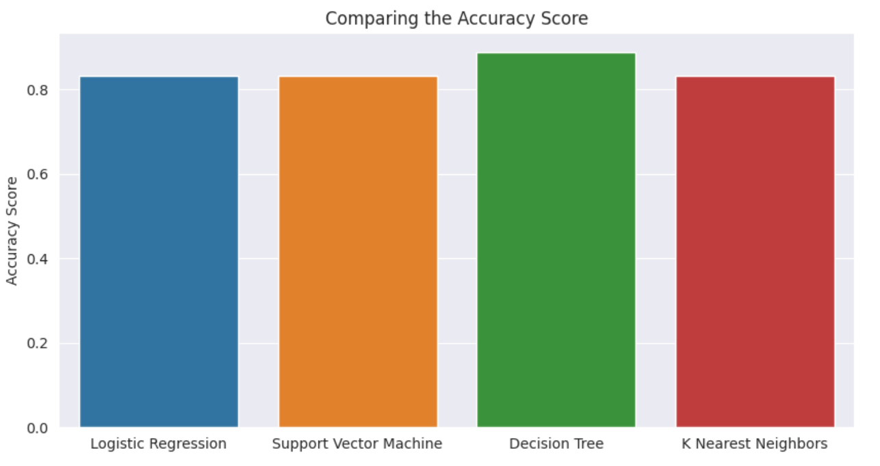
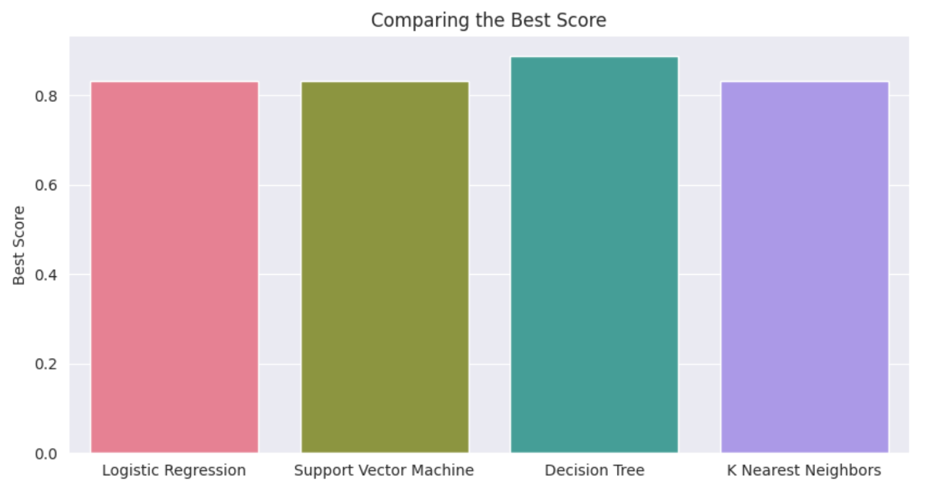
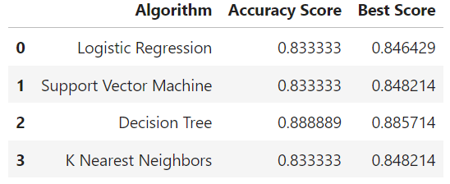
Appendix - Best Accuracy vs. Best Score
Comparing the results side by side, we learn that Decision Tree is the best performing model for our analysis. It is slightly better than all the other models we used.

Slide 50
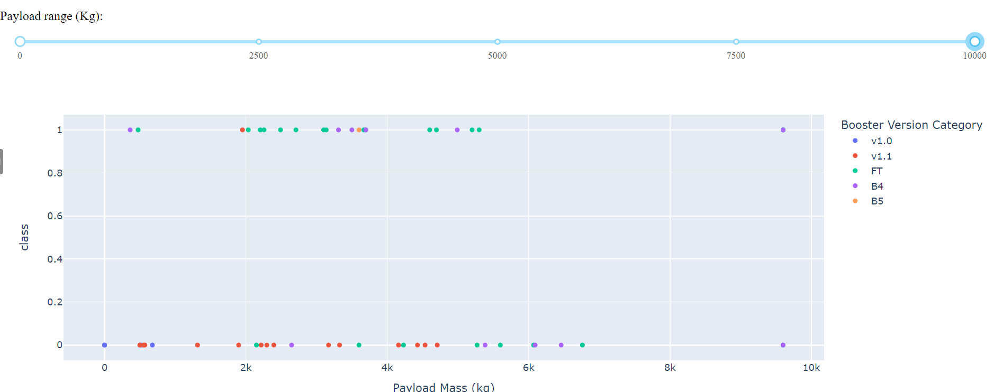
Appendix - Payload Mass vs. Class, Best Booster Version
We learn that success rate is higher when payload mass is lesser than 6000kgs and Booster Version FT has highest success rate

Slide 51


